Slide 1
Virus Detection Acceleration
Analyzing Performance: Different Methods of Payload Scans for Malicious Signatures
01.03.24

Slide 2




About Us
Itai Benyamin
Idan Baruch
Computer Engineering Student
Computer Engineering Student

Slide 3
Motivation

Slide 4
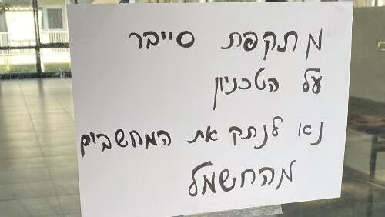
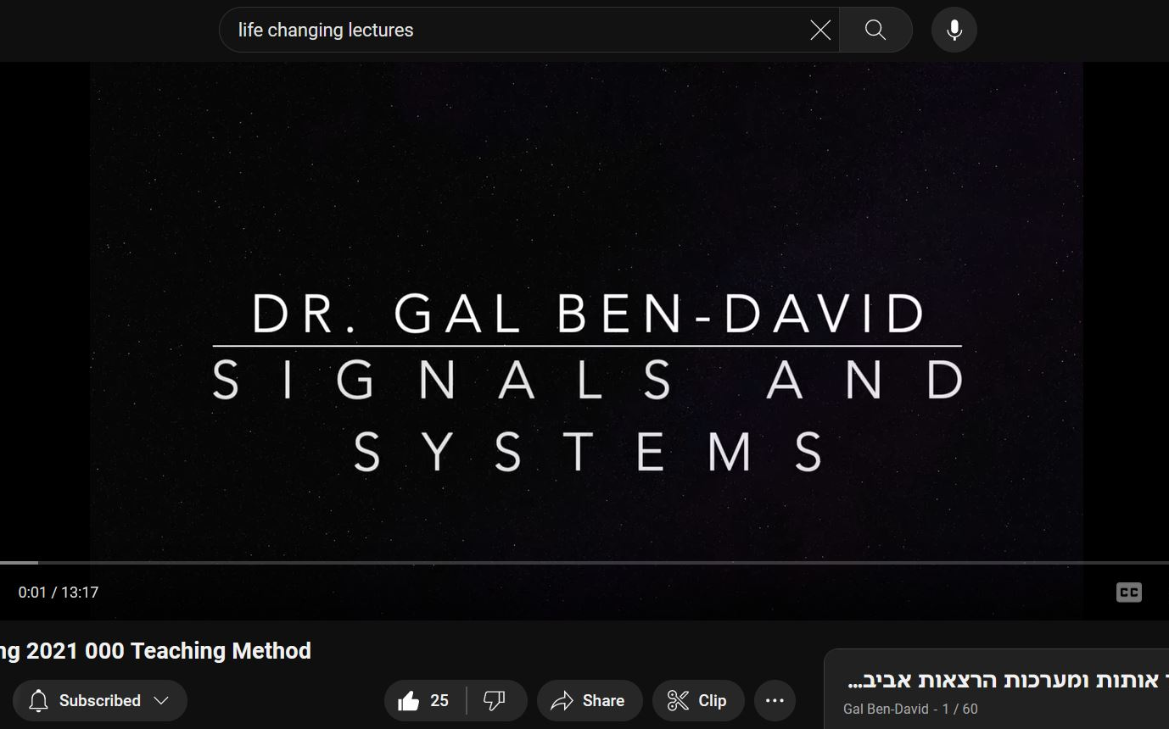

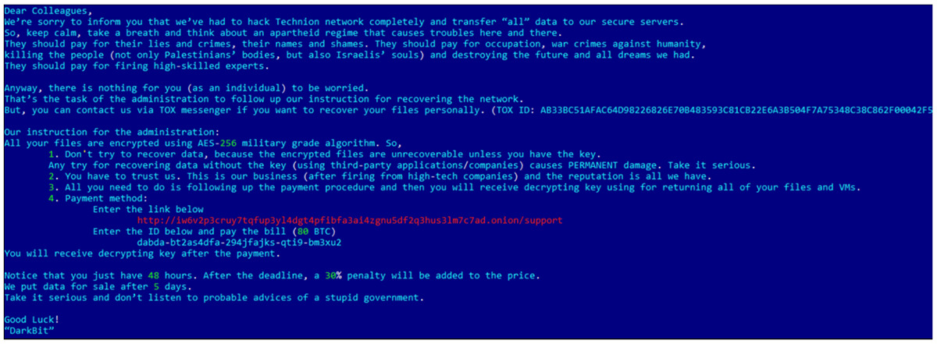

Why Accelerating Payload Scanning?
Faster payload scanning means faster packets classification:
Under cyber attacks
Reduce response time prevents further damage
During heavy traffic
Reduce slowdowns or bottlenecks in traffic processing
Notes:
** REDUCE TO 2 PHOTOS
** MAKE ANIMATION QUEUED TIMED / GIF
** CHANGE TO TABLET TEMPLATE
The primary focus of accelerating signature scanning is enhancing threat detection capabilities and reducing response times.
During heavy traffic it may reduce slowdowns or the bottlenecks in traffic processing (normal heavy traffic = most packets are *not* malicious = a need of fast classifier of threats vs normal traffic)
Under cyber attacks

Slide 5

Background

Slide 6
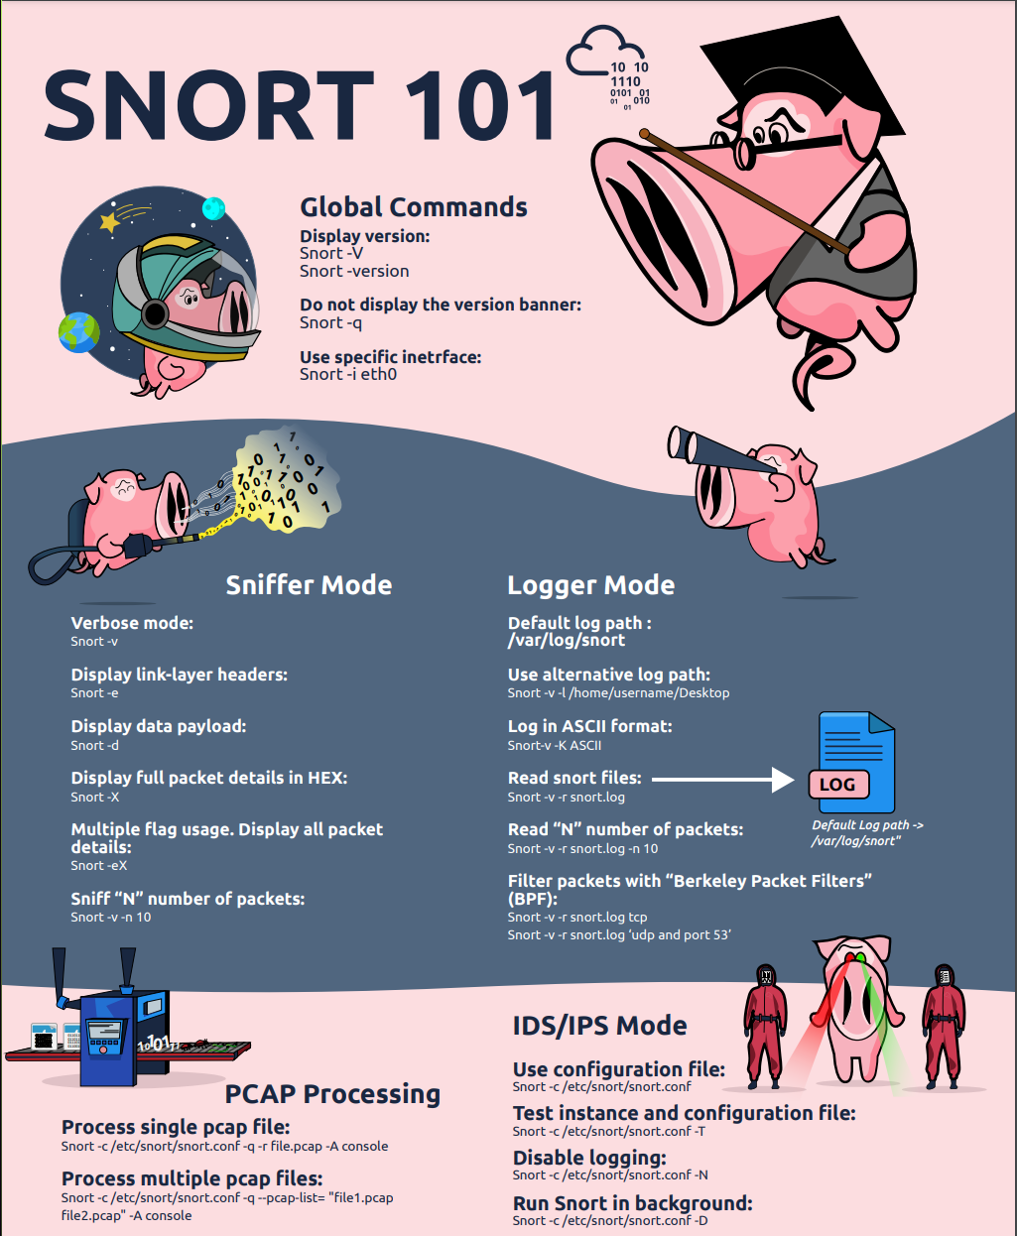

What is Snort?
Snort is an open-source intrusion prevention system capable of real-time traffic analysis and packet logging
Snort has three primary uses (modes):
Packet Sniffer (like tcpdump)
Packet Logger (for network traffic debugging)
NIPDS (Network Intrusion and Prevention Detection System)

Slide 7
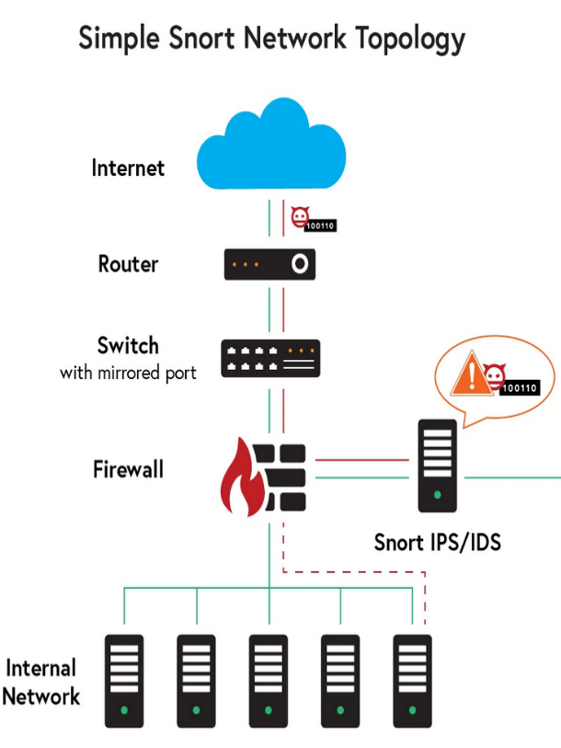

How Does it Work
Snort Intrusion Prevention System (IPS) uses a series of rules that help define malicious network activity
This network analysis provide real-time logging and alerting of events and traffic
Notes:
** TODO: change direction of slide **

Slide 8

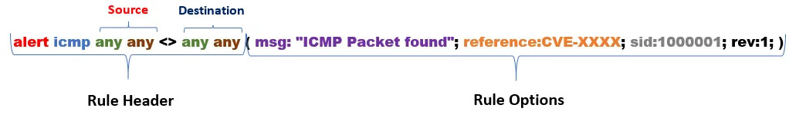

Snort Rules
Snort uses rules to find packets that match against them and generates alerts for users
Rules have two main parts:
Rule Header
Rule Options
Notes:
https://www.snort.org/

Slide 9
Snort Rules
Rule Header:
Action
Protocol
Source (IP, port)
Direction (orientation of traffic)
Destination (IP, port)
Notes:
* Rule Header (metadata)
Action
Protocol
Source (IP, PORT)
Direction operator – Identifies the orientation of traffic (<>, ->, <-)
Destination (IP, PORT)
* Rule Options
Message Displayed / Logged
Reference for rule’s origin and information
SID (Snort rule ID)
Number of revisions and changes to this rule
And more…

Slide 10
Snort Rules
Rule Options:
General Rule Options (message logged, rule id, reference, # of revisions)
Payload Detection Options (content, pcre)
Non-Payload Detection Options
Post-Detection Rule Options
Notes:
** STRESS: the speedup potential of a single component of snort’s parsing affects the entire system.
* Rule Header (metadata)
Action
Protocol
Source (IP, PORT)
Direction operator – Identifies the orientation of traffic (<>, ->, <-)
Destination (IP, PORT)
* Rule Options
Message Displayed / Logged
Reference for rule’s origin and information
SID (Snort rule ID)
Number of revisions and changes to this rule
And more…

Slide 11
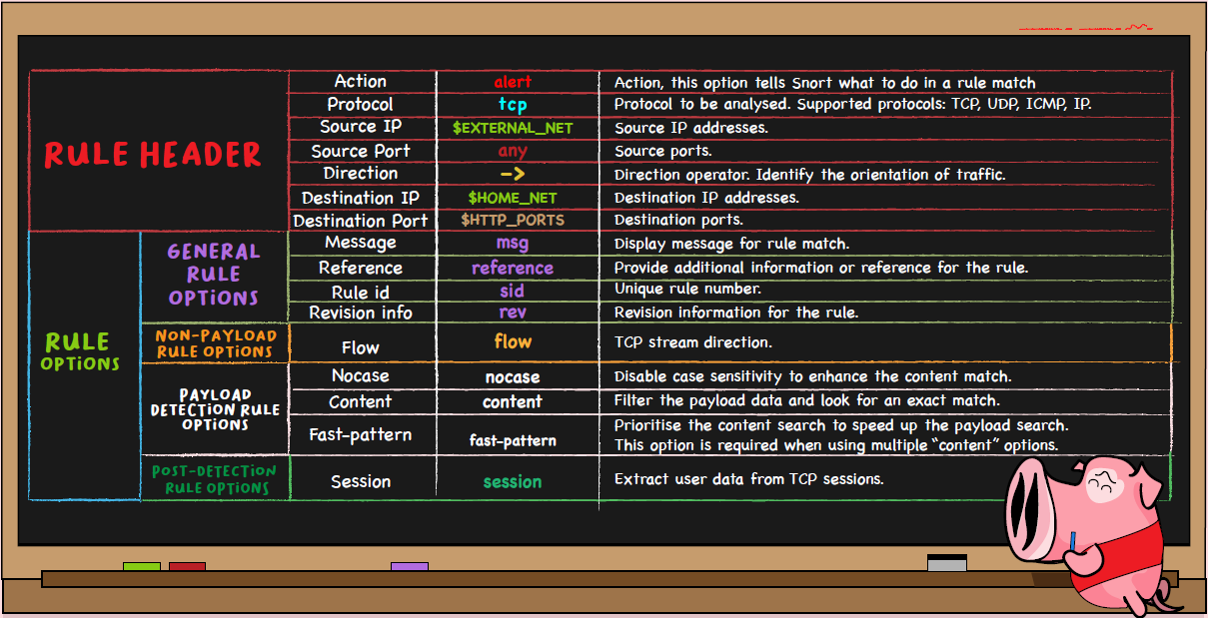
Snort Rules
Notes:
* Rule Header (metadata)
Action
Protocol
Source (IP, PORT)
Direction operator – Identifies the orientation of traffic (<>, ->, <-)
Destination (IP, PORT)
* Rule Options
Message Displayed / Logged
Reference for rule’s origin and information
SID (?)
Number of revisions and changes to this rule
And more…

Slide 12

Data Processing

Slide 13
Data Processing: From Data to Information
Rules
Predefined detection guidelines to identify specific network traffic patterns
alert tcp any any -> any any ( msg:”malware download request”; content:”?message=“; pcre:”/(info|app)\x2ephp\x3fmessage\x3d/”; )
Signatures
Unique identifiers within a rule that help to investigate and detect specific patterns in the payload data packets
content:”?message=“ pcre:”/(info|app)\x2ephp\x3fmessage\x3d/”
Exact Matches
Deterministic components of signatures, removing any wildcards or elements that allow for multiple interpretations or ambiguity
[“?message=“, “info”, “app]
[“info”, “?mes”, “essa”, “sage”]
Substrings
Segments or tokens extracted from an exact match, with specified length and gap between each other
Notes:
https://www.snort.org/downloads/#rule-downloads
Rule[2743]: alert tcp $HOME_NET any -> $EXTERNAL_NET $HTTP_PORTS ( msg:"MALWARE-OTHER Win.Trojan.Kuluoz outbound download request"; flow:to_server,established; http_uri; content:"?message=",fast_pattern,nocase; pcre:"/(info|app)\x2ephp\x3fmessage\x3d/"; metadata:impact_flag red,policy max-detect-ips drop,policy security-ips drop,ruleset community; service:http; reference:url,malwaremustdie.blogspot.com/2013/09/302-redirector-new-cushion-attempt-to.html; classtype:trojan-activity; sid:28006; rev:2; )
Signatures: [pcre:"/(info|app)\x2ephp\x3fmessage\x3d/“, content:"?message=“]
Exact Matches: [“?message=“, “info”, “app”]
Substrings:
L=8, G=1: [“?message”, “message=“]
L=4, G=1: [“info”, “?mes”, “mess”, “essa”, “ssag”, “sage”, “age=“]
L=4, G=2: [“info”, “?mes”, “essa”, “sage”]
"payload data" refers to the actual data being transmitted over a network, excluding any additional control information or headers.
“deterministic components” are the fixed sequences of characters that match exactly in the input data. These components do not contain any wildcards or variable elements that allow for multiple interpretations.

Slide 14
General Information after ‘SnortRuleParser’ Execution
4,031
Rules were extracted from ‘snort3-community.rules’
2.9%
Rules were without a content/pcre signature
Unique signatures of ‘content’ type, the rest are ‘pcre’
Unique exact matches extracted (out of 15,488 total exact matches)
86.6%
32.1%

Slide 15
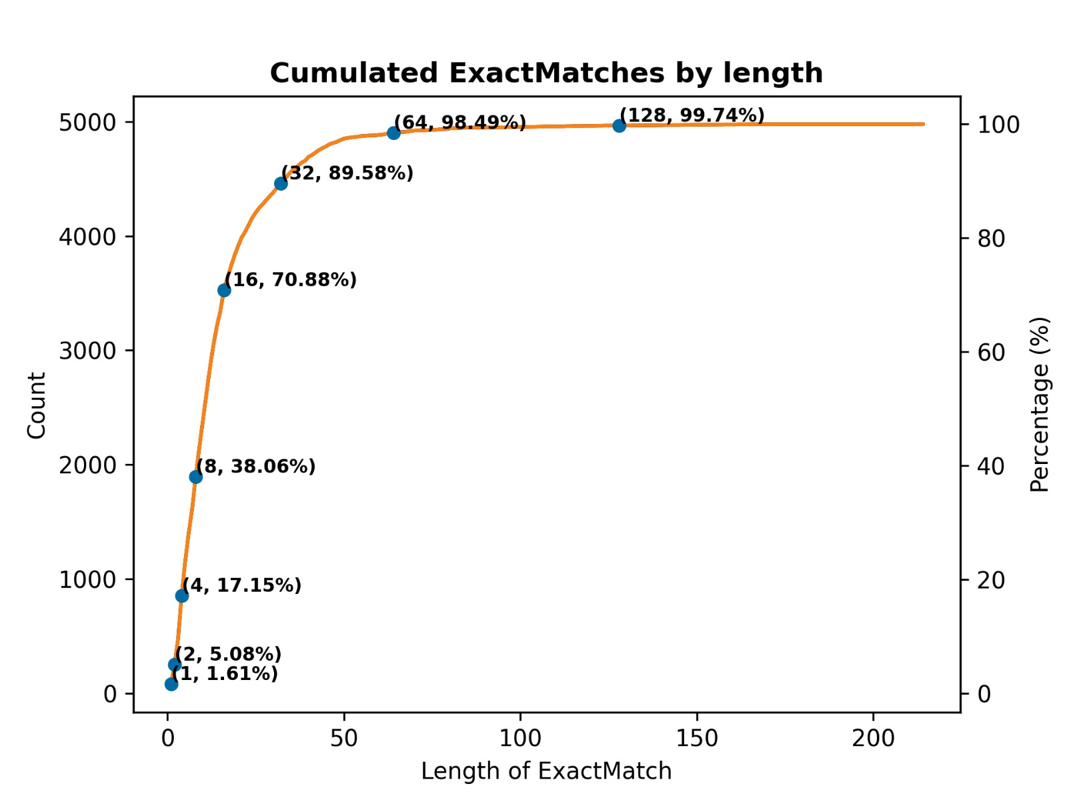
Notes:
Accumulating the # and % of Exact Matches extracted with Length > threshold

Slide 16
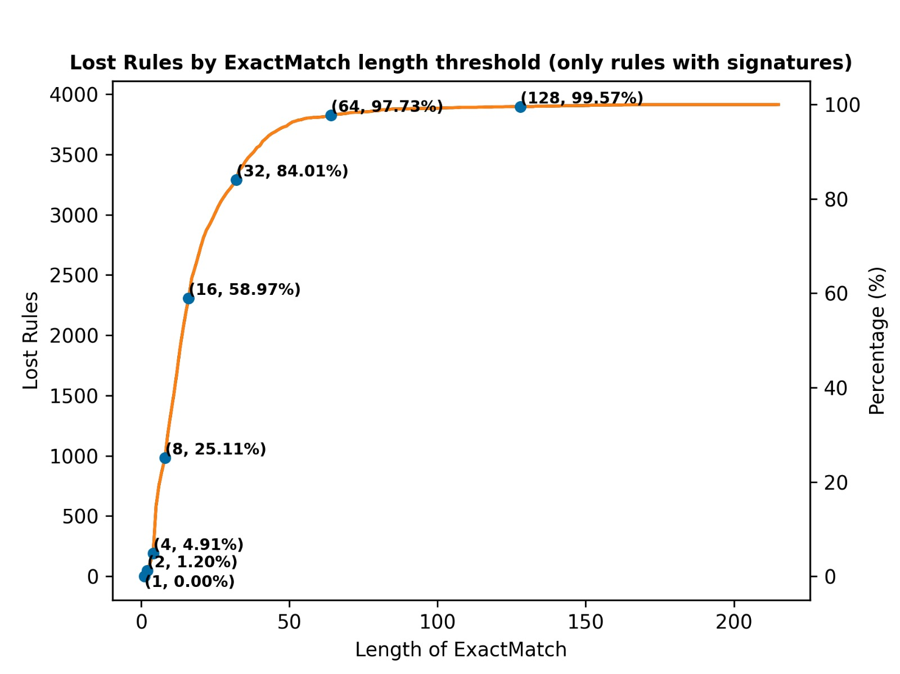
Notes:
# and % of lost rules by selecting threshold and looking only at Exact Matches with Length > threshold

Slide 17

Performance Analysis

Slide 18
Percentage of Unique Substring with Length (L) and Gap (G)
L=8, G=1:
L=8, G=2
56.4%
24,940 Unique Substrings
19,259 Duplicates Removed
60.7%
13,946 Unique Substrings
9,026 Duplicates Removed
L=4, G=1
L=4, G=2
35.1%
21,065 Unique Substrings
38,881 Duplicates Removed
41.4%
12,900 Unique Substrings
18,245 Duplicates Removed
Notes:
**TODO: find another way to present it , maybe a HEATMAP**
L=8 G=1: 24940 Unique Substrings, 19259 Duplicates Removed
L=8 G=2: 13946 Unique Substrings, 9026 Duplicates Removed
L=4 G=1: 21065 Unique Substrings, 38881 Duplicates Removed
L=4 G=2: 12900 Unique Substrings, 18245 Duplicates Removed

Slide 19
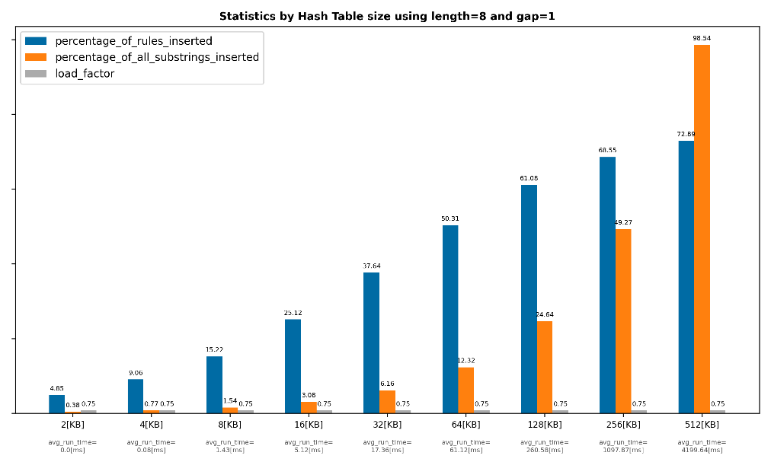
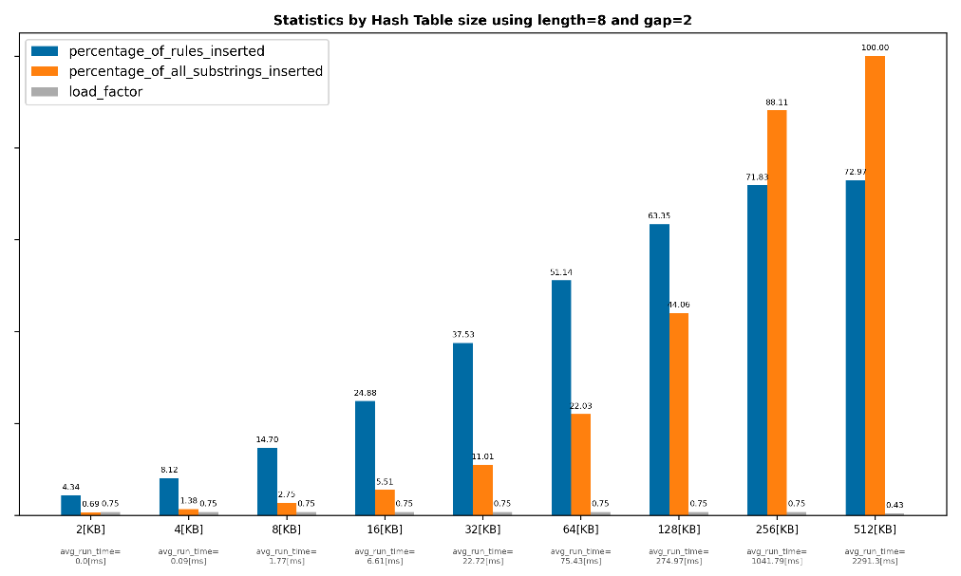
Inserting L=8 Substrings to Hash Table of Different Sizes
Substrings of Length 8, Gap 1
Substrings of Length 8, Gap 2
* Data averaged over 100 tests for each table size
Notes:
Data averaged over 100 tests for each table size

Slide 20

* Data averaged over 100 tests for each table size
Notes:
Data averaged over 100 tests for each table size

Slide 21
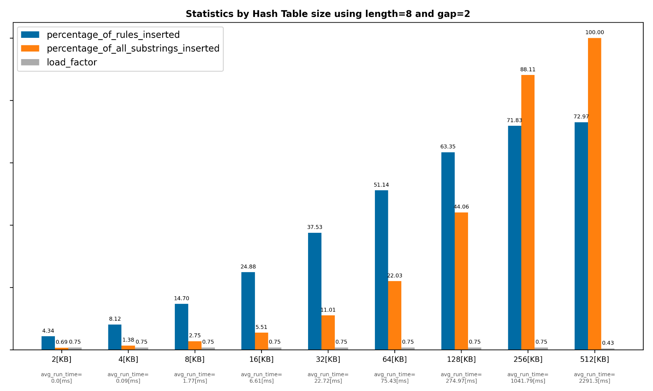
* Data averaged over 100 tests for each table size
Notes:
Data averaged over 100 tests for each table size

Slide 22
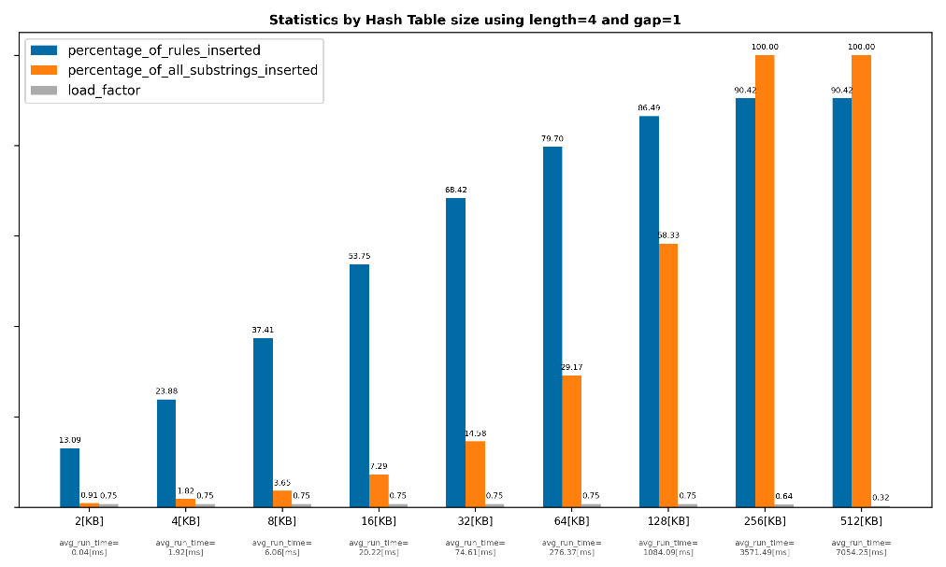
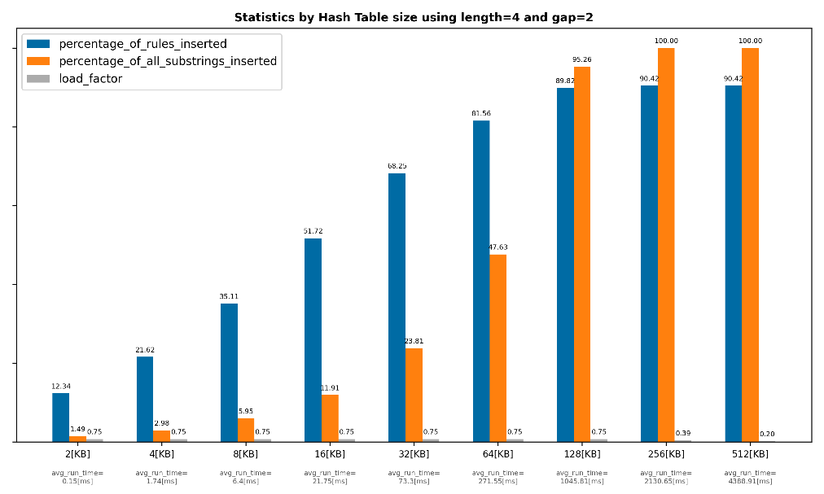
Inserting L=4 Substrings to Hash Table of Different Sizes
Substrings of Length 4, Gap 1
Substrings of Length 4, Gap 2
* Data averaged over 100 tests for each table size
Notes:
Data averaged over 100 tests for each table size

Slide 23

* Data averaged over 100 tests for each table size
Notes:
Data averaged over 100 tests for each table size

Slide 24
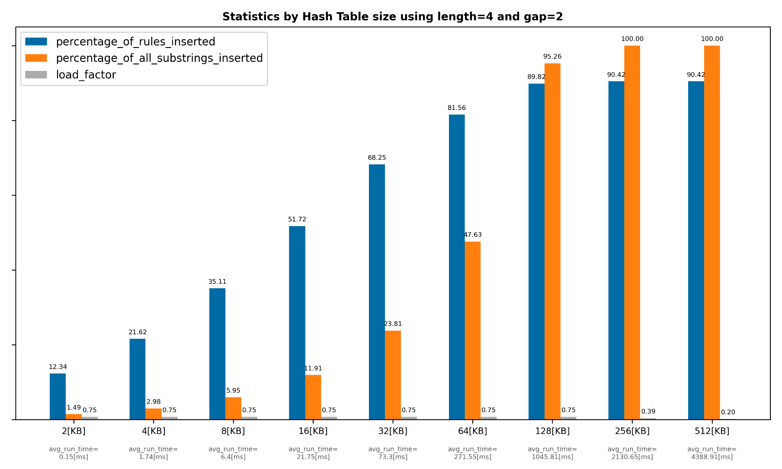
* Data averaged over 100 tests for each table size
Notes:
Data averaged over 100 tests for each table size

Slide 25
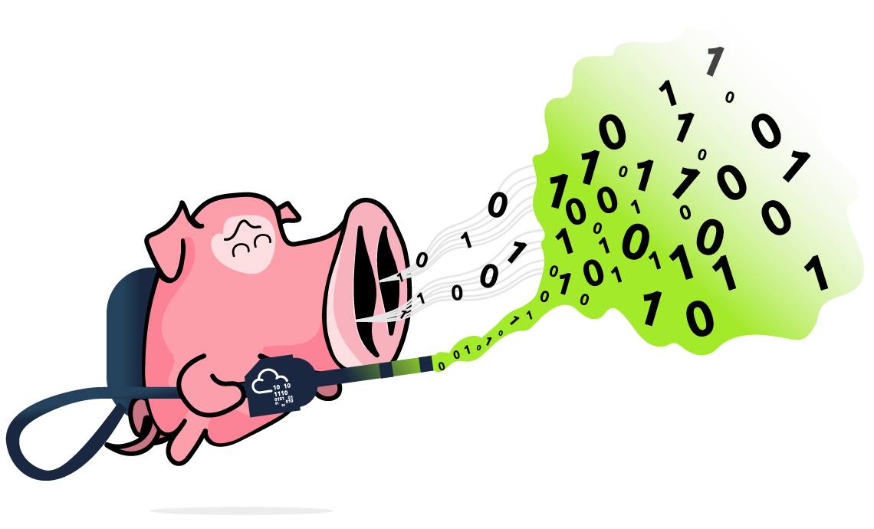
Summary & Conclusions

Slide 26


Thank you for listening!

